Slide 2
Recon
Passive
Active

Slide 3
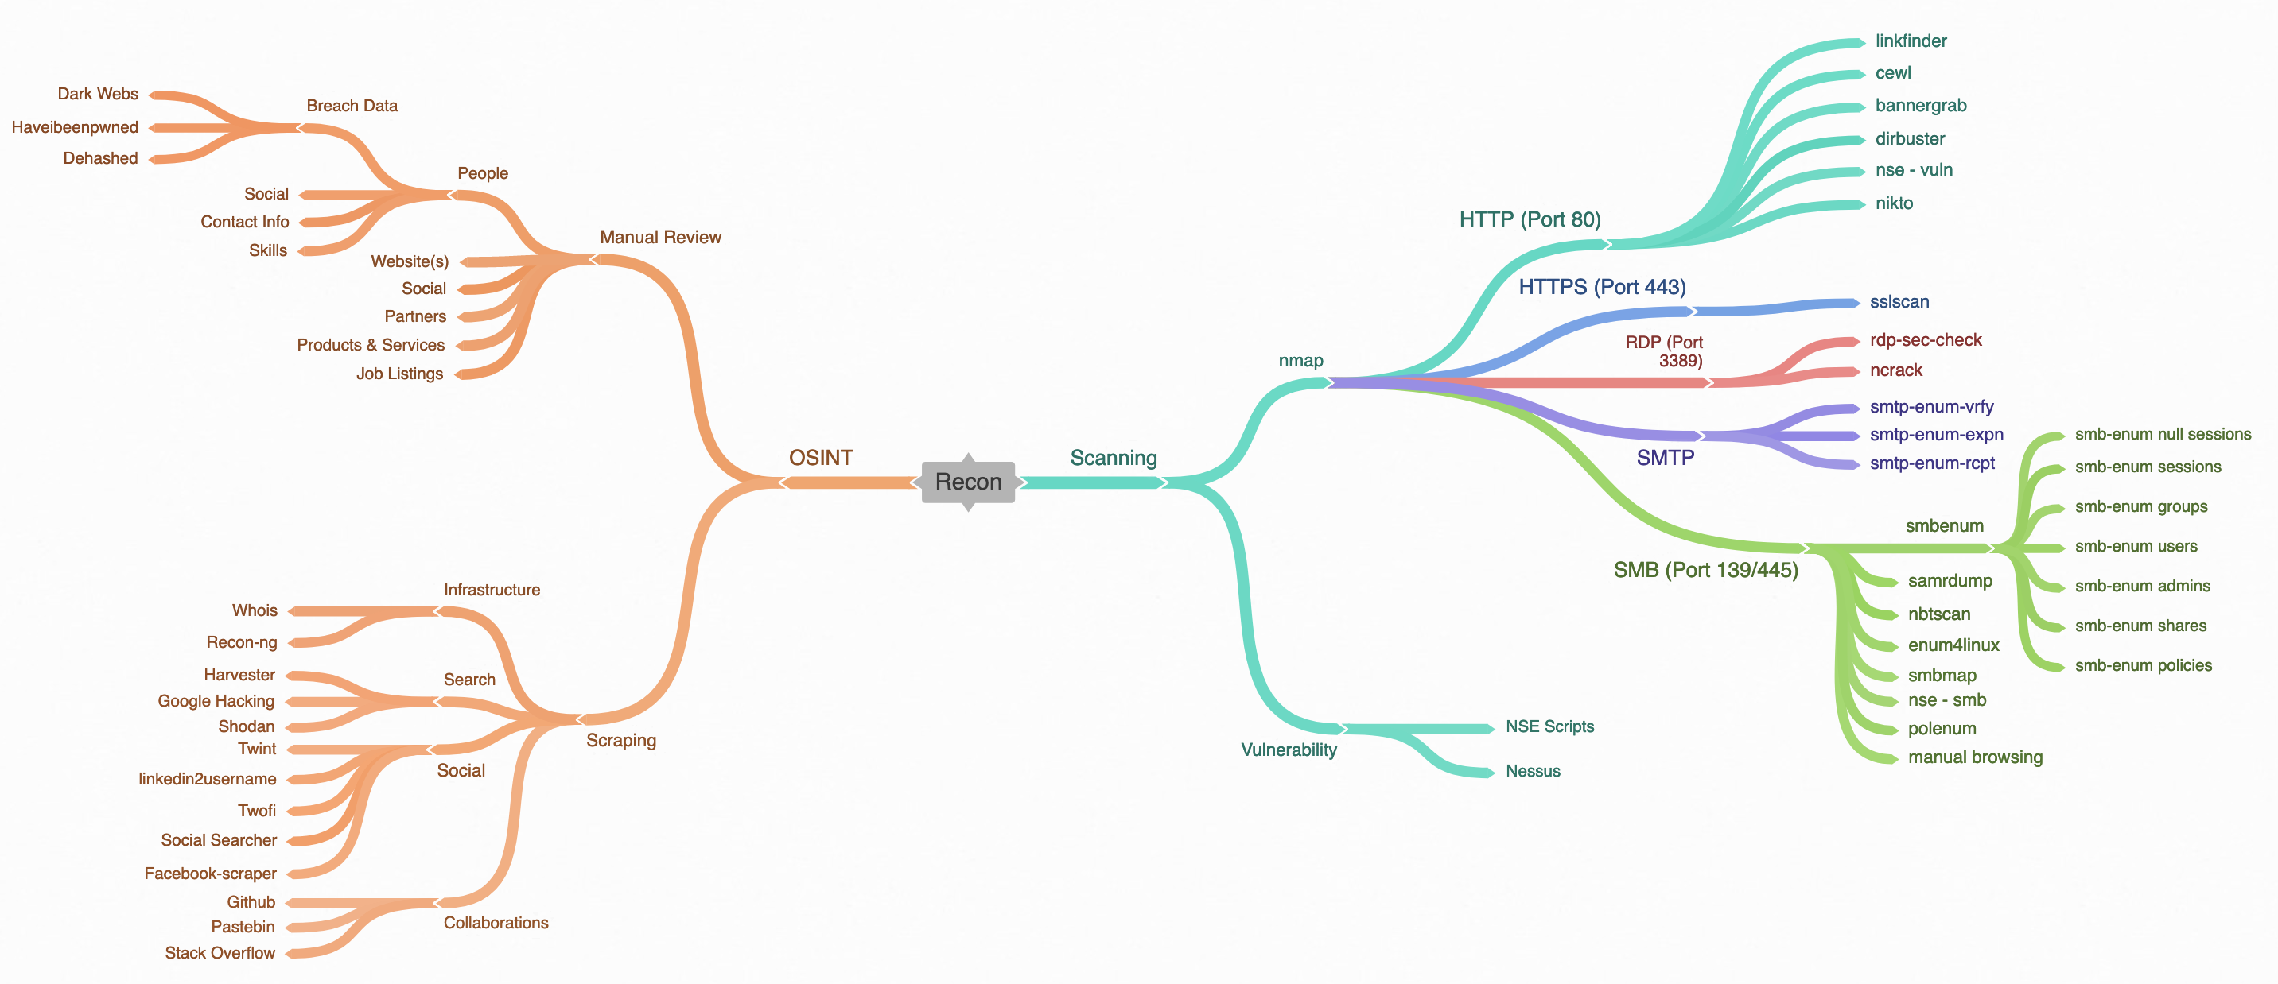
A Brief Guide to Recon

Slide 4
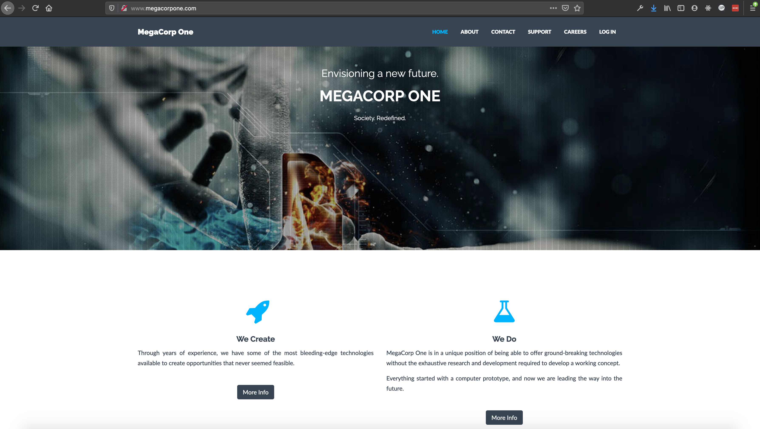
Something to play with
www.megacorpone.com

Slide 5
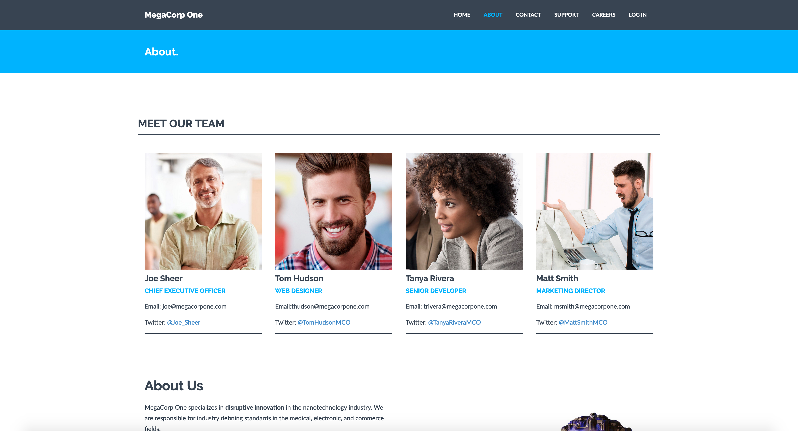
Let’s take a look around…

Slide 6
Wait a minute…what are we doing with this info…

Slide 7
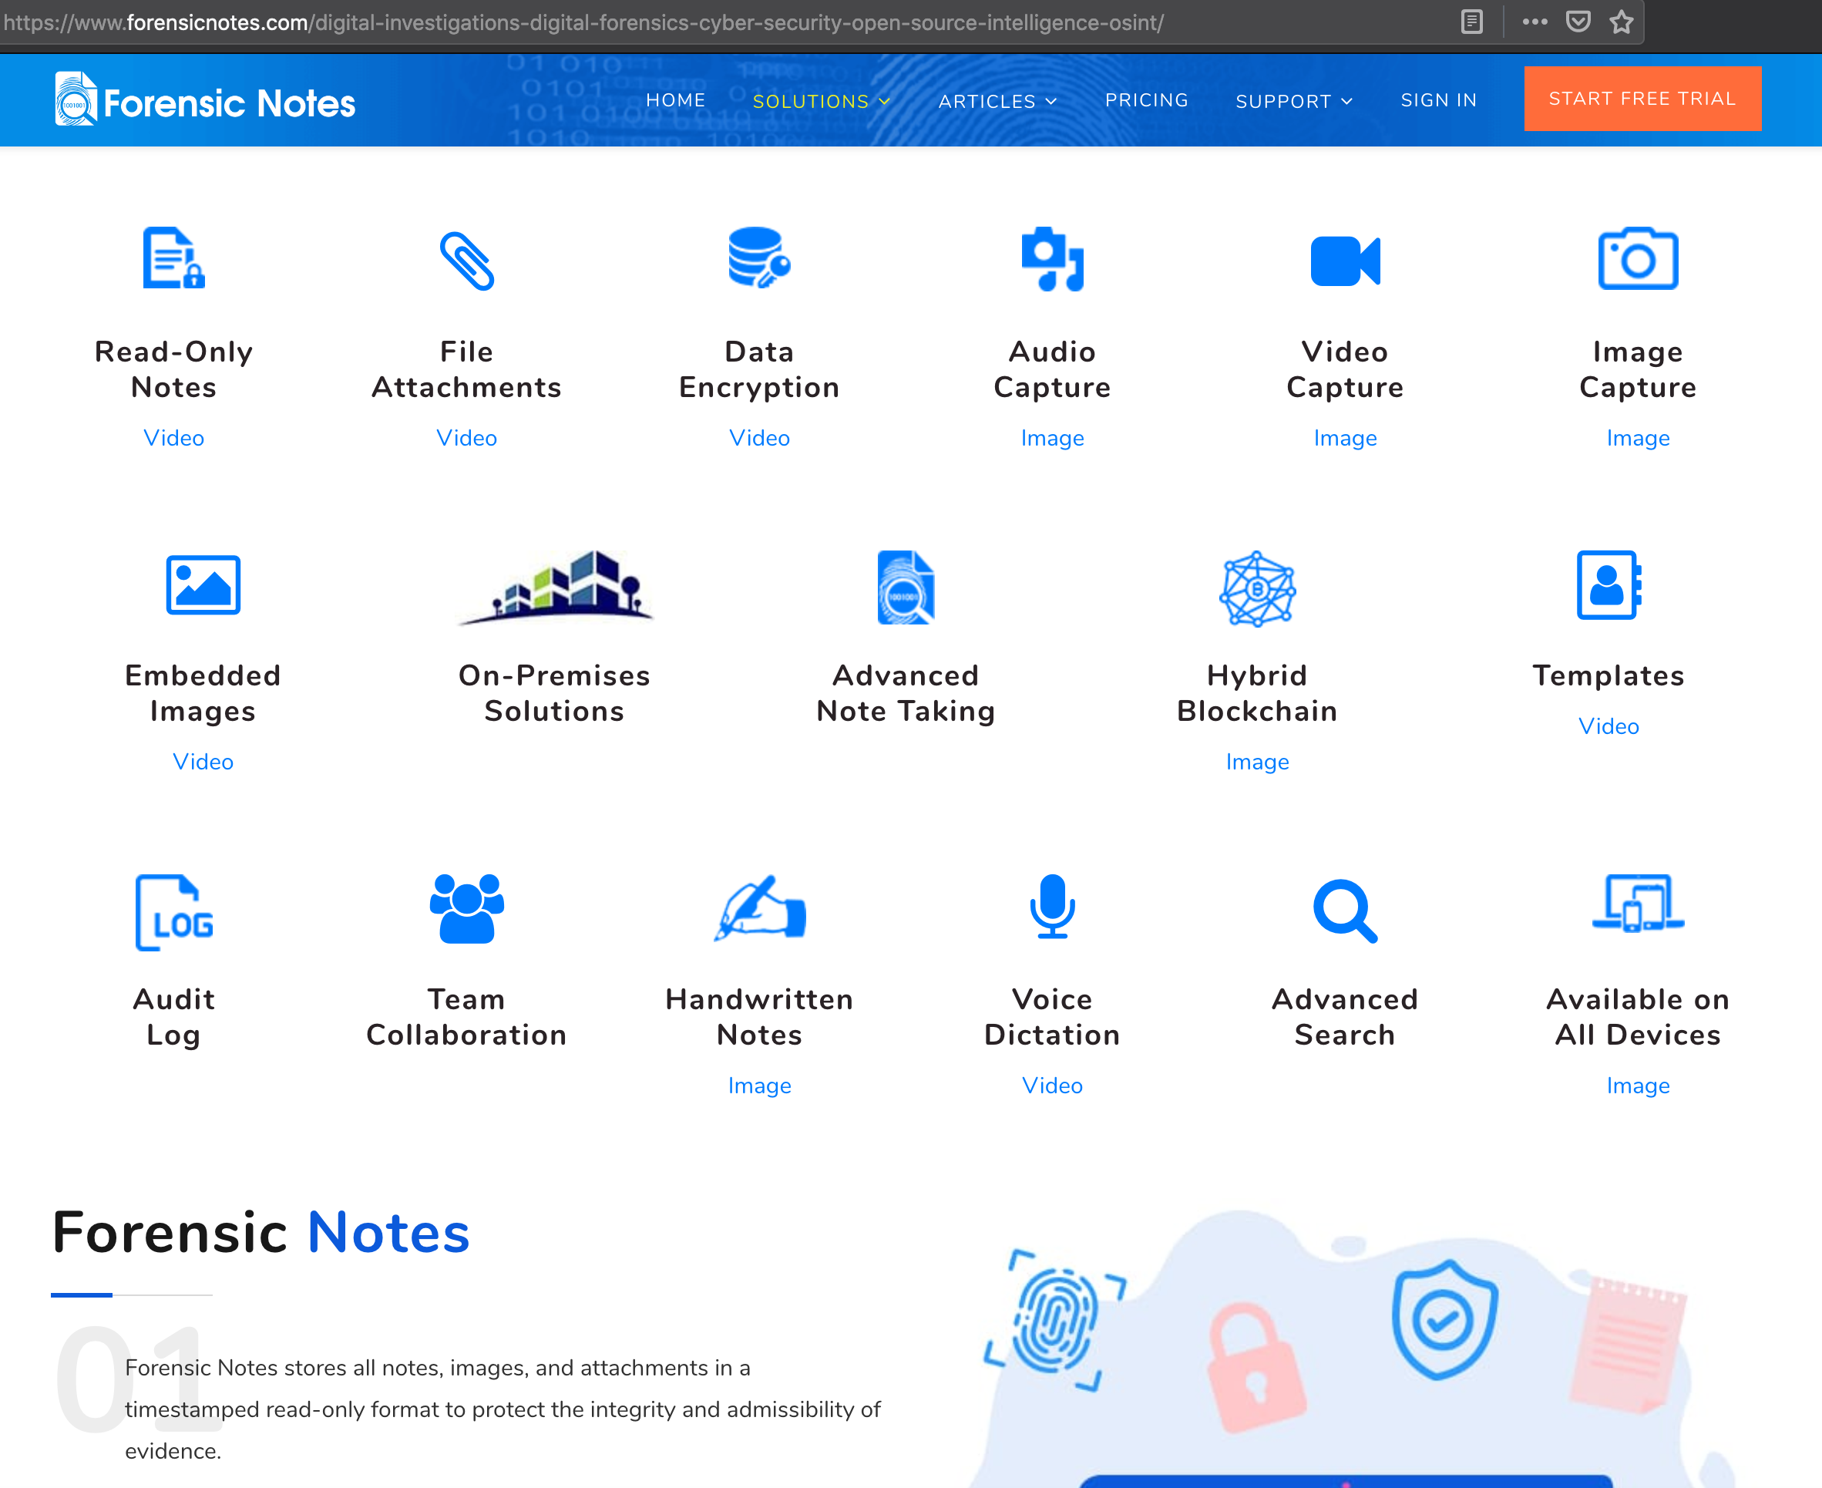
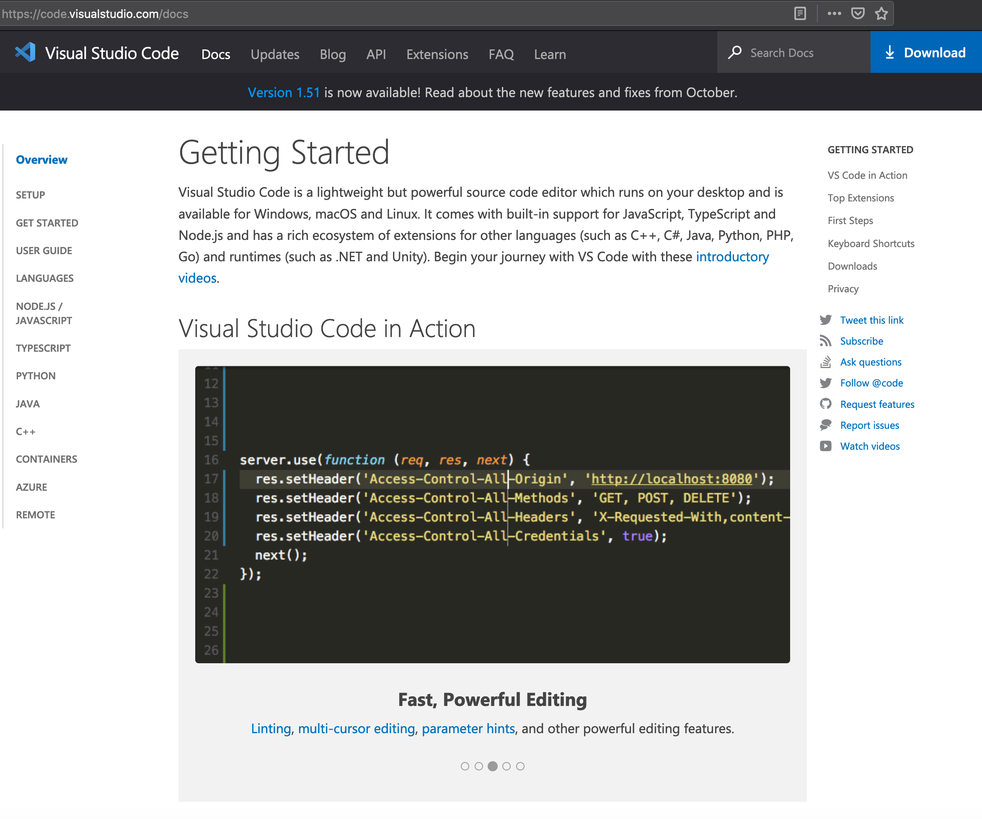
Write everything down…
Make sure that you use a tool and structure your findings in a way that makes sense to you and that you can go back to for report writing or quick reference

Slide 8
A Brief Guide to Recon

