Slide 1
OSCP Topic 4: Web Application Attacks
Introduction to the OWASP Top 10

Slide 2
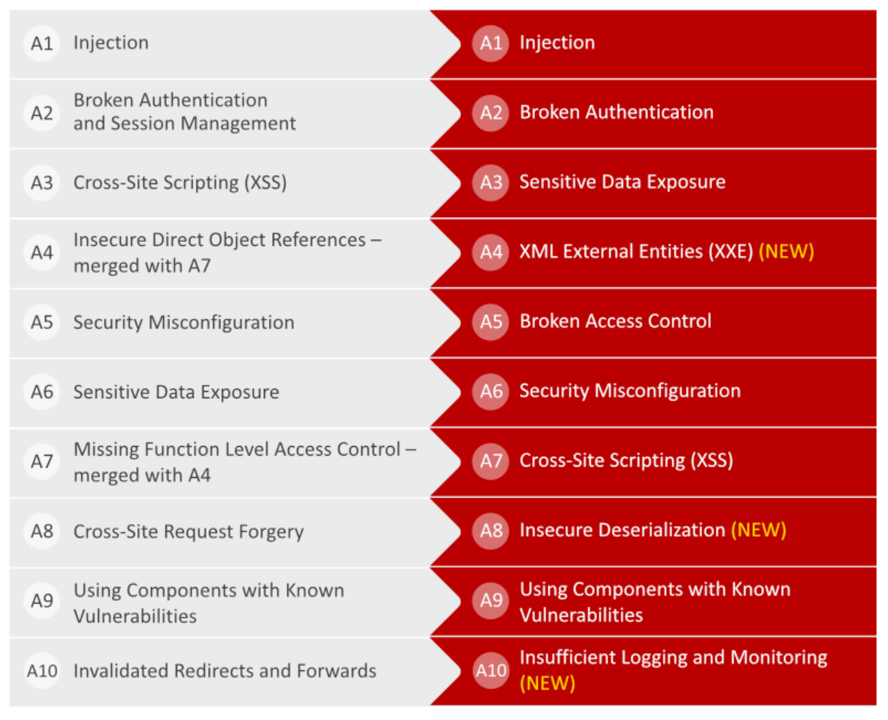
What is the OWASP Top 10
2013
2017
Created by The Open Web Application Security Project
An awareness document for developers and security professionals
The 10 most critical web application vulnerabilities
2020 version is still under development

Slide 3
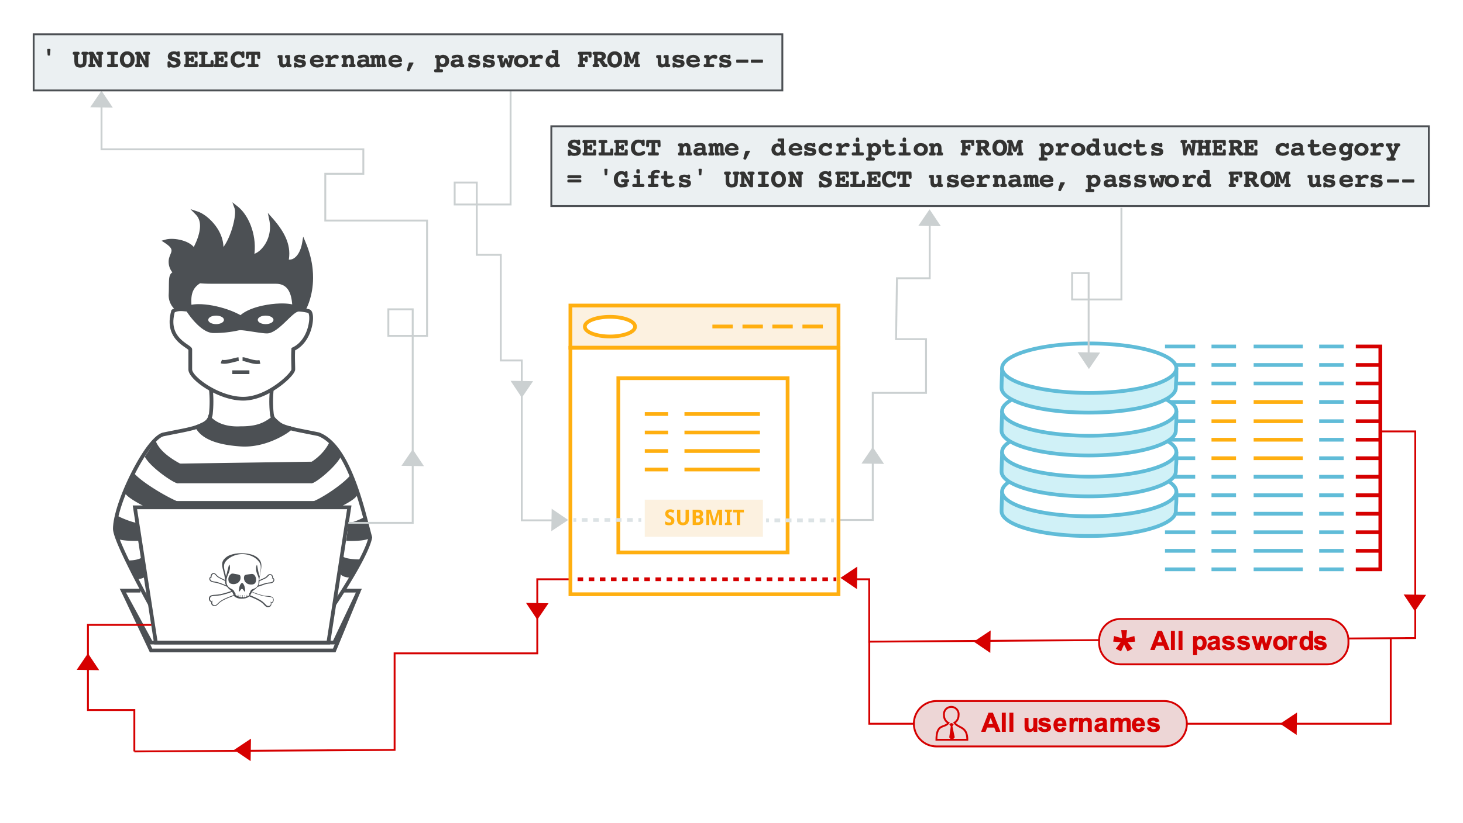
Injection Attacks
SQL Injection (SQLi)
NoSQL Injection
LDAP Injection
OS Command injection

Slide 4
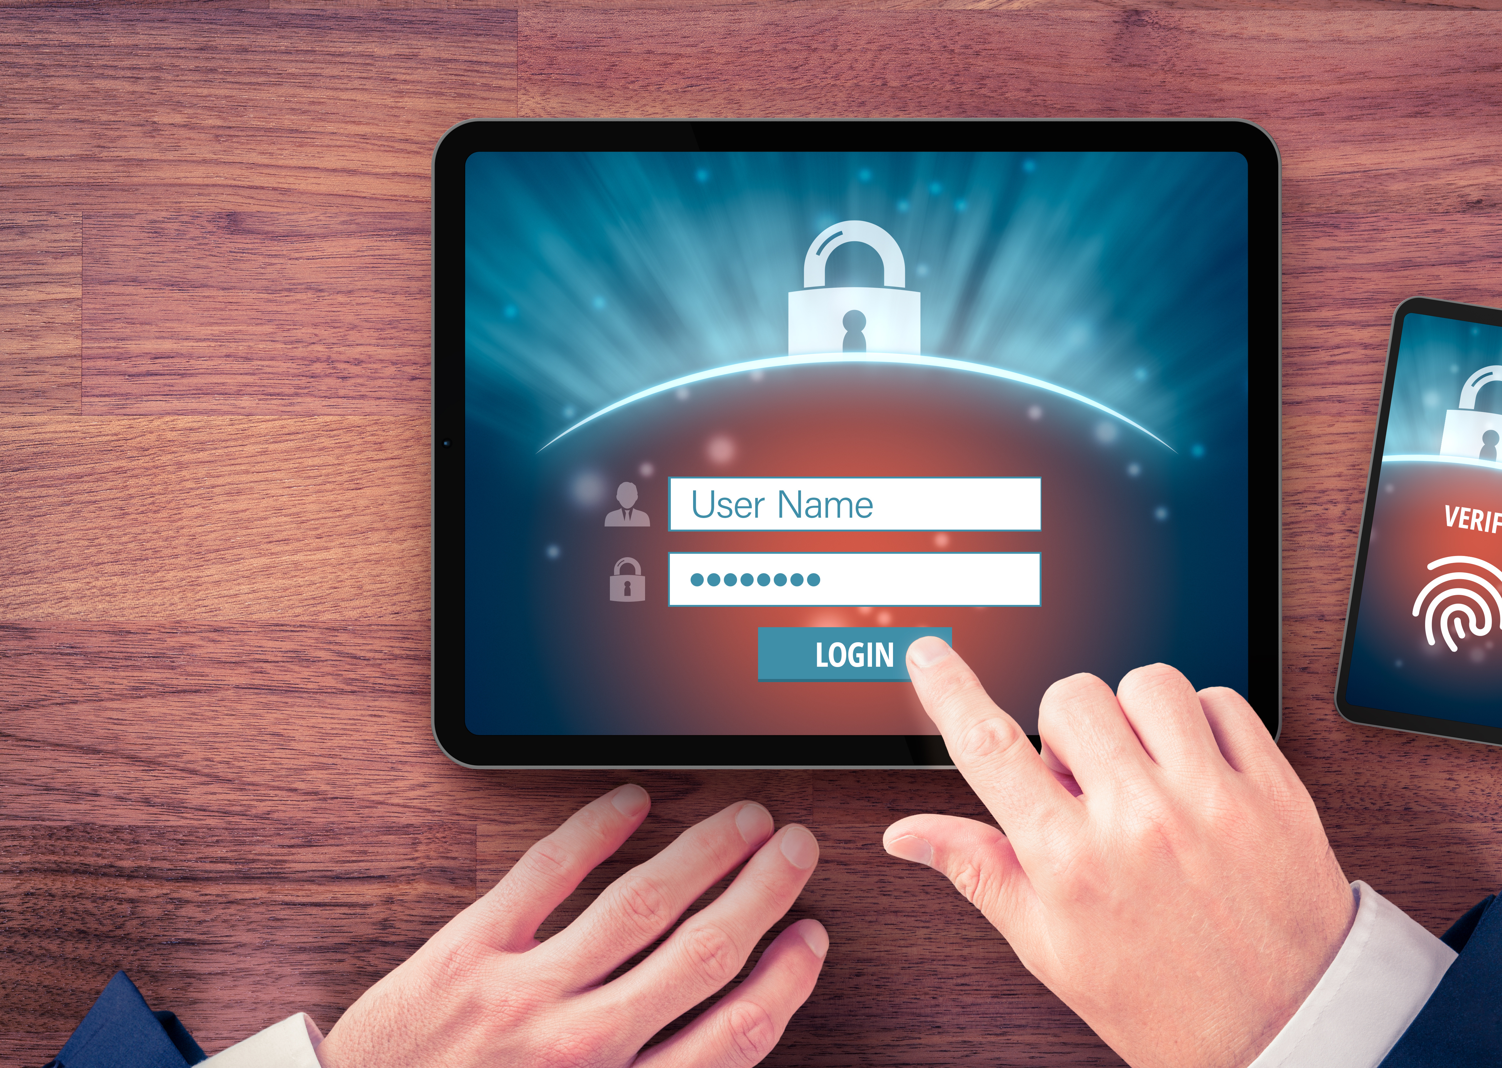
Broken Authentication
Unencrypted Login Traffic
Soft Passwords
Session Exposure
Unclosed Sessions
Fixed Sessions

Slide 5
Sensitive Data Exposure
Data Exfiltration using methods like MitM attacks
Unencrypted sensitive data
Website Cashing Problems

Slide 6
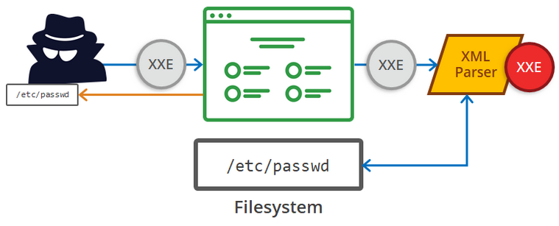
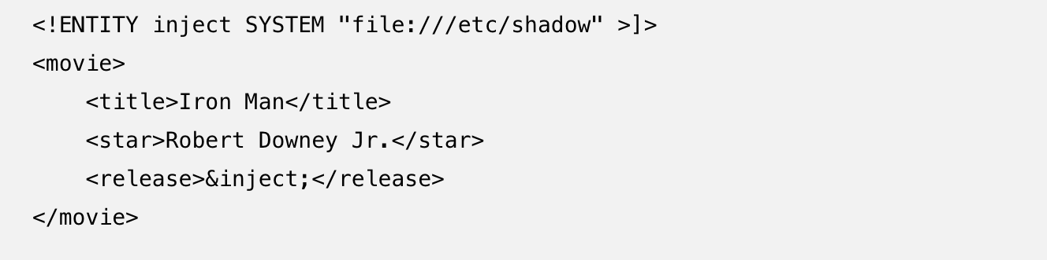
XML External
Entities
/etc/shadow
/etc/shadow
File/URL Inclusion
A dying breed, XML is being phased out by many applications
Being replaced by simpler datatypes such as JSON
This XML Injection…
Would display this in the output…

Slide 7
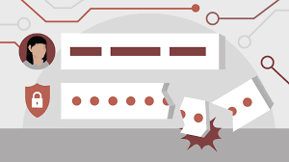
Broken Access Control
Bypass authorization
Carry out tasks as a privileged user
Countered by web-based token authentication

Slide 8
Security Misconfiguration
Bypass authorization
Carry out tasks as a privileged user
Countered by web-based token authentication

Slide 9
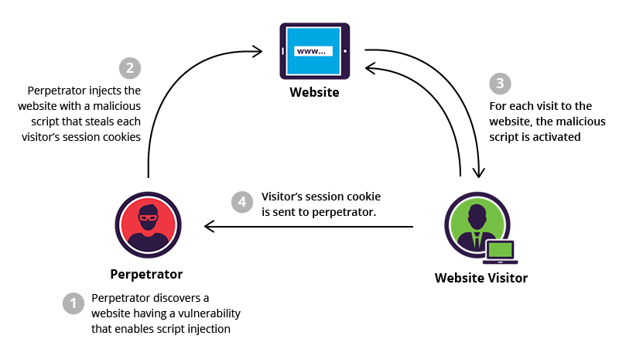
Cross Site Scripting (XSS)
Three Types of XSS
Stored
Reflected
DOM-Based

Slide 10
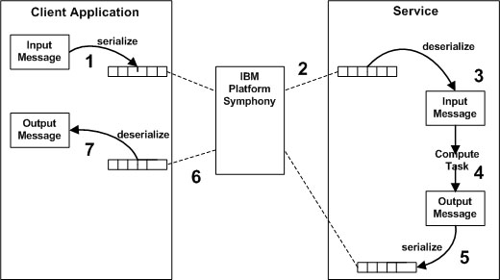
Insecure Deserialization
Remote Code Execution
DoS and DDoS Attacks

Slide 11
Known
Vulnerabilities
External Components
Common Libraries
Unpatched Systems
Unsupported Systems

Slide 12
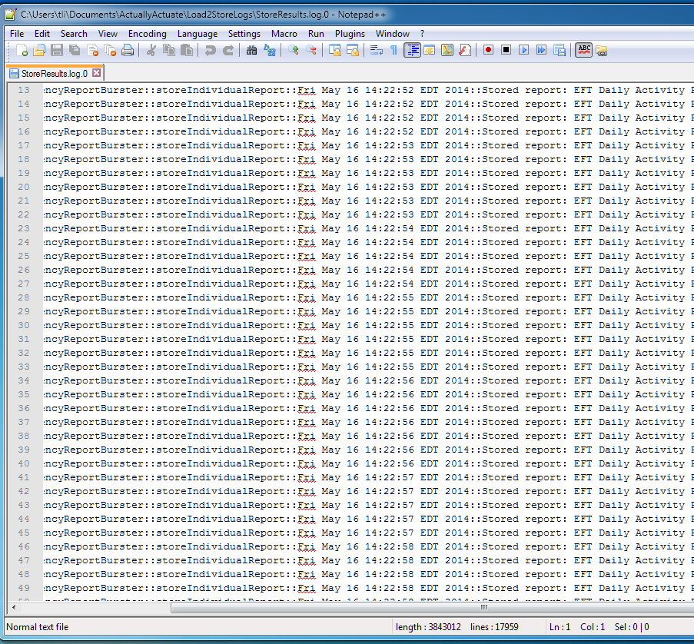
Insufficient Logging
& Monitoring
Average breach discovery time 2019 was 206 days according to IBM
Average time to contain the breach was 73 days
Herjavec Group estimates that a business will fall victim to Ransomware every 11 seconds in 2021
This Photo by Unknown Author is licensed under CC BY-SA

Slide 13
Finding Web Vulnerabilities
SQLMap
Burpsuite
Nexpose
Nikto
WPScan

Slide 14
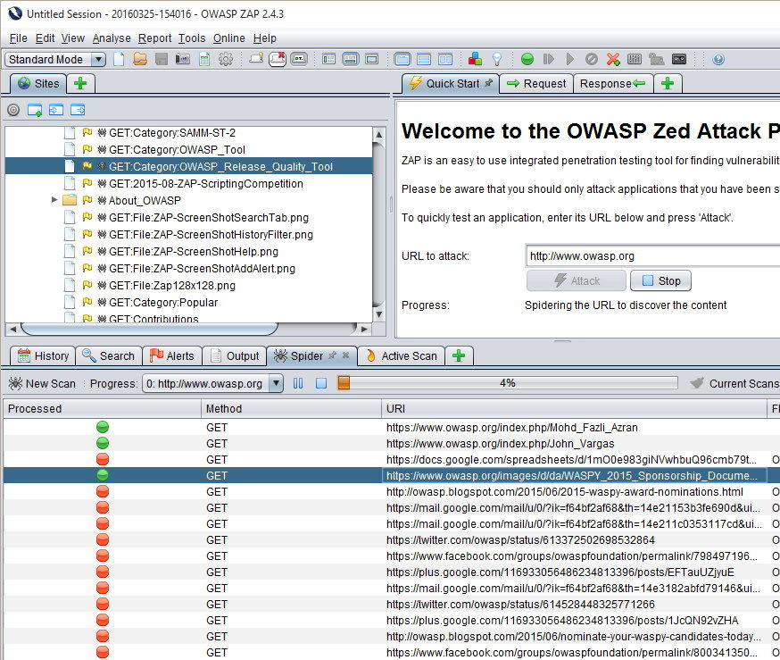
OWASP ZAP
(Zed Attack Proxy)
Included with Kali Linux inc the latest 2020.4 release
Unlike other Proxies, such as Burp, it has the ability to scan/attack sites automatically

